Slide 1
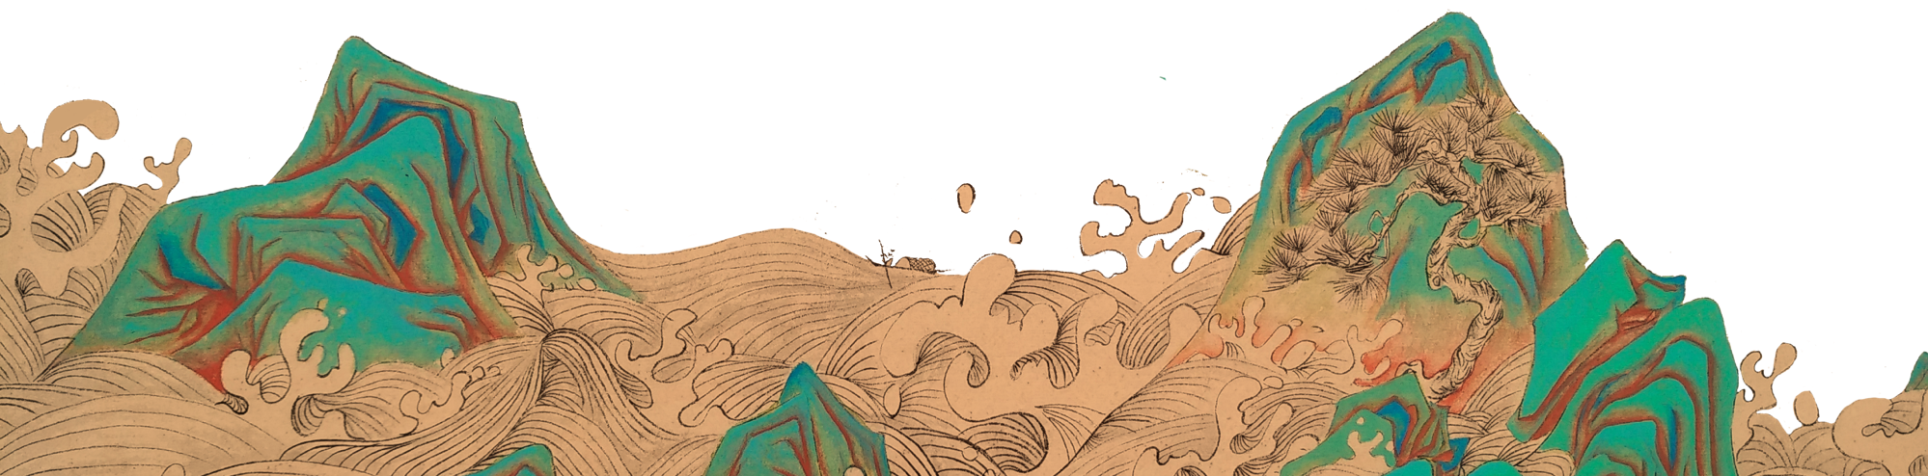
The Classic of Mountains and Seas
HUMA5630
Group 3

Slide 2
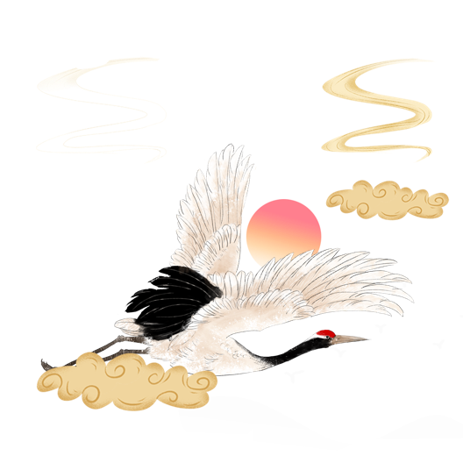
Table of Content
HUMA5630
Group 3
1·Project Introduction
2·Research Questions
3·Project Findings
4·Workflow & Demo
5·Project Challenges
6·Future Improvement

Slide 3
1. Project Introduction

Slide 4
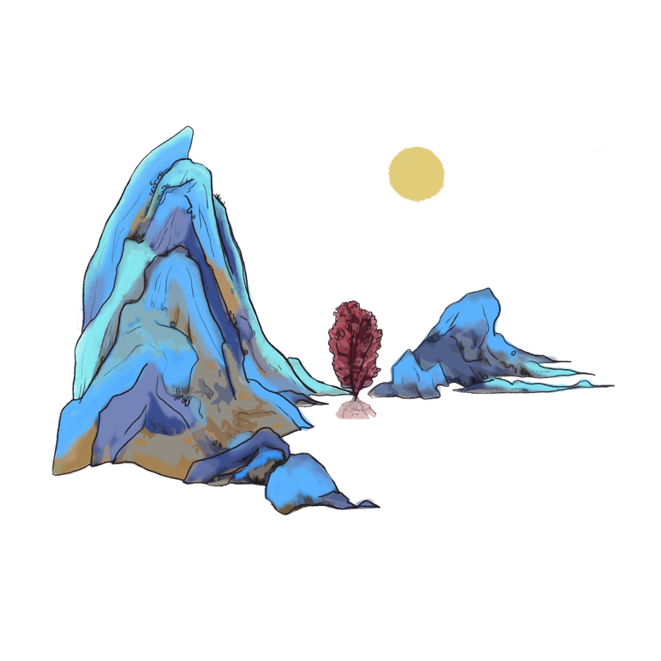
1. Project Introduction
Primary Objective:
· utilize modern technology present 'The Classic of Mountains and Seas'.
· to bring to life this fascinating world in ancient Chinese myths and showcase their fascination.

Slide 5
1. Project Introduction
Research methodology, including but not limited to......
·Text analysis
·Spatial mapping
·Data analysis

Slide 6
2. Research Questions

Slide 7
How can we gain insight into the world of ‘The Classic of Mountains and Seas’?
1. What modern technologies can be used to better analyze this classic work and enhance readers' understanding of the content for both domestic and foreign readers?
2. Is there any connection between the map in this classic and the modern map? And how can we explore the changes between the map depicted in this literary work and the modern map?
3.How can various mythical creatures in the classic work be presented clearly and interestingly? What aspects can be used to present them?

Slide 8
3. Project Findings

Slide 9
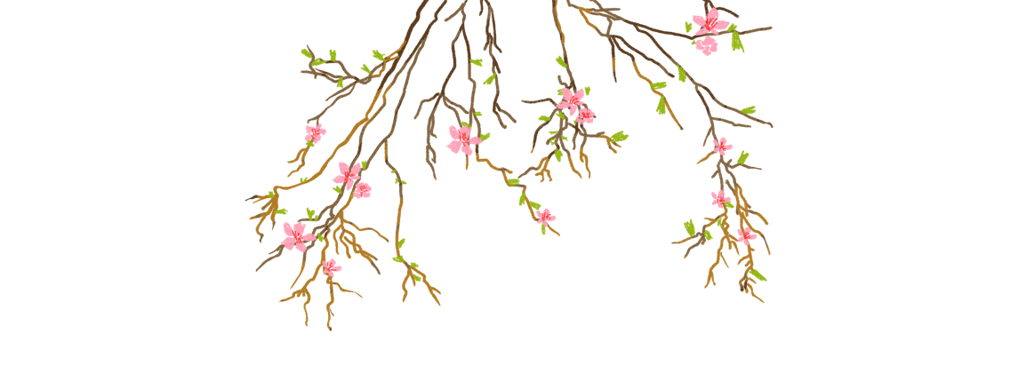
3. Project Findings
Firstly, this project analyzes the text,......
This part utilized various techniques, such as word cloud analysis of high-frequency words, annotation on the full text, and full text display, which were visually presented to provide a more intuitive understanding of the text's content. To enhance the reader's comprehension of the Classic, different color blocks were implemented in the text to distinguish attributes of words, such as characters, monsters, treasures, and locations.
Secondly, investigates the geographic descriptions in the Classic through mapping......
This section conducted an in-depth investigation of the complex distribution of countries and rivers mentioned in the text, using geographical descriptions to gain insight into the ancient mythological world. Additionally, an ancient map was investigated and compared with a modern map to clarify three geographical coordinates.

Slide 10
3. Project Findings
Thirdly, the categorization of mythical creatures in the classic ......
The part delved into the mythical creatures portrayed in this work, offering a fascinating and distinctive approach to exploring the text's content. This includes examining the quantity and classification of creatures, and utilizing pie charts to illustrate the distribution of creature numbers in each chapter and the proportion of each creature type. Additionally, the part provided original texts and translations of relevant mythical creatures, with the goal of helping readers gain a more vivid comprehension of them.

Slide 11
4. Workflow & Demo

Slide 12
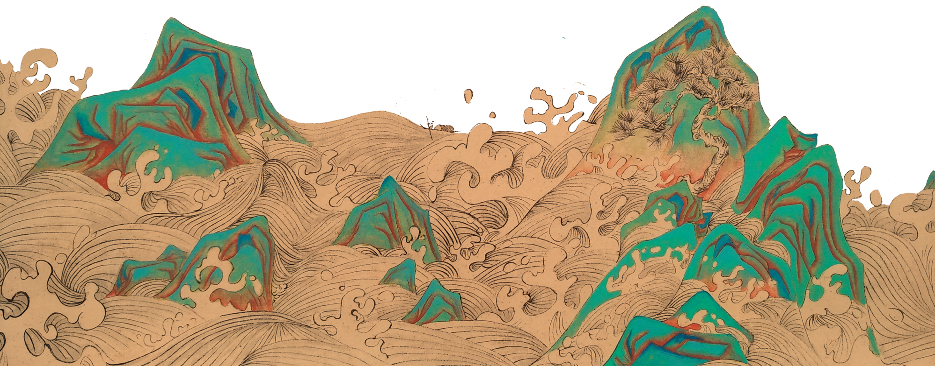
Textual analysis + Full text Display
Part One
Presenter: Shen Xiaohan

Slide 13
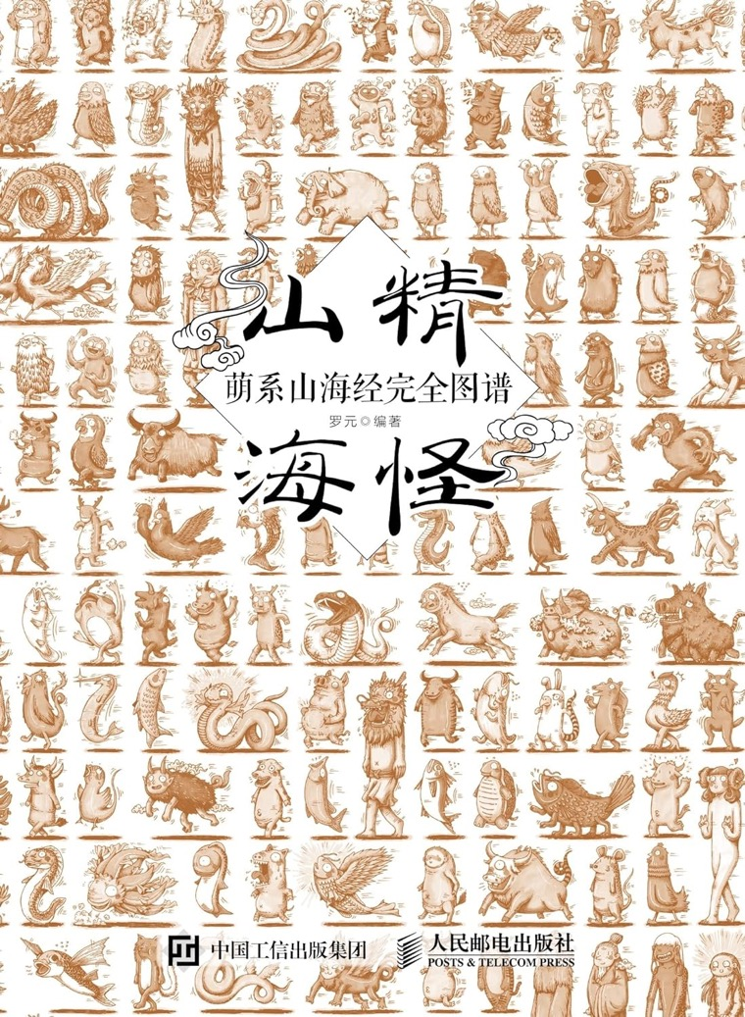
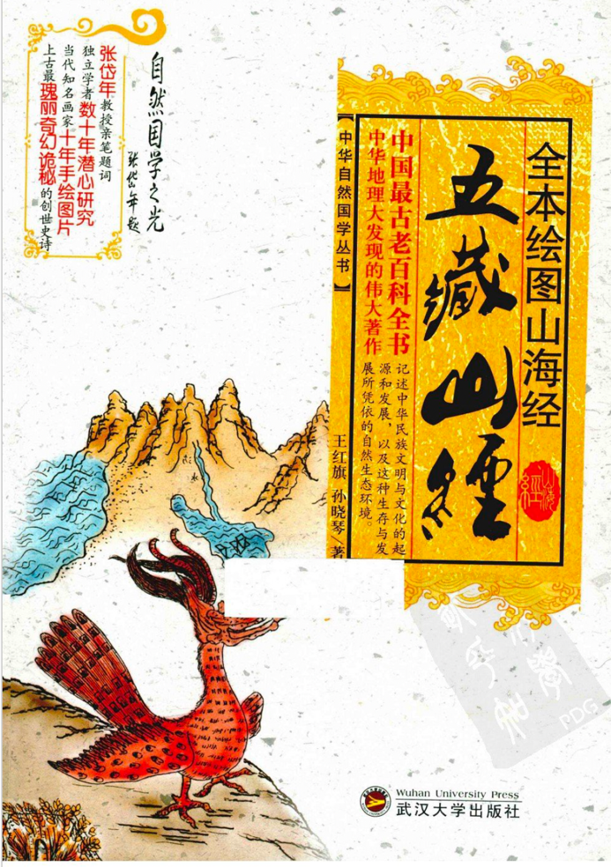
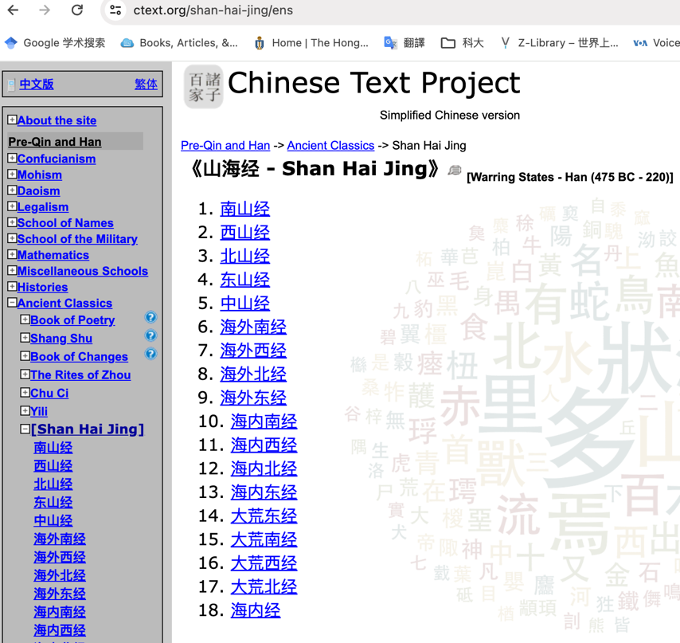
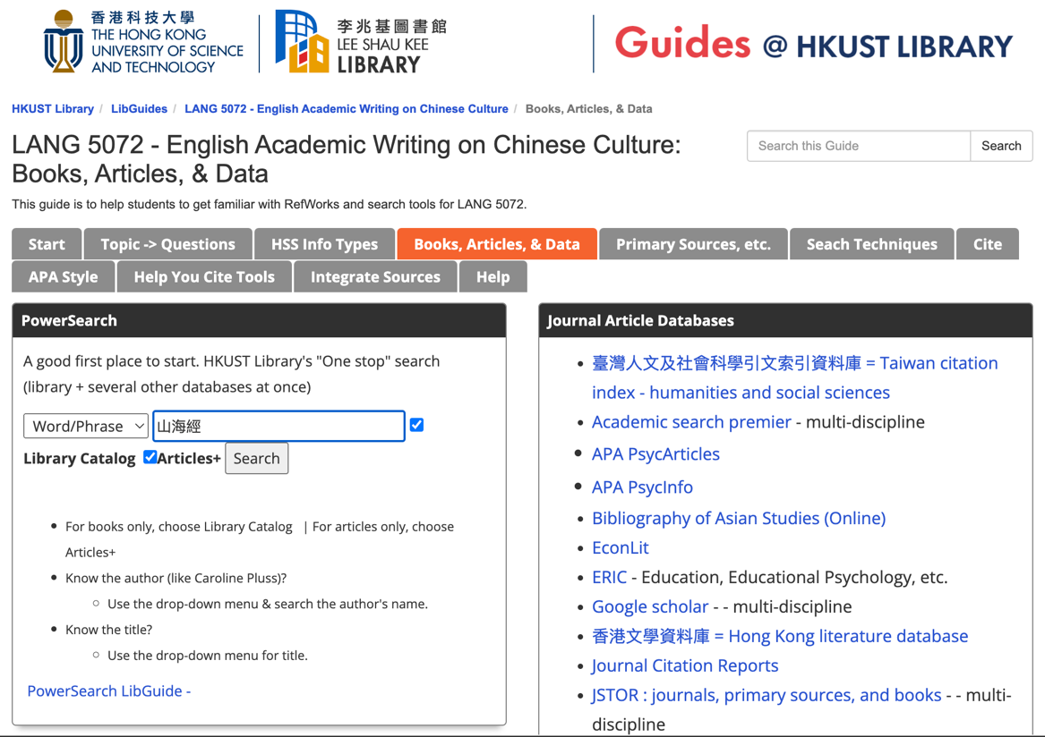
HUMA5630 Group3 Shen
01. Acquiring Humanities Data
https://ctext.org/shan-hai-jing/ens
https://libguides.hkust.edu.hk/lang5072/books-articles-data

Slide 14
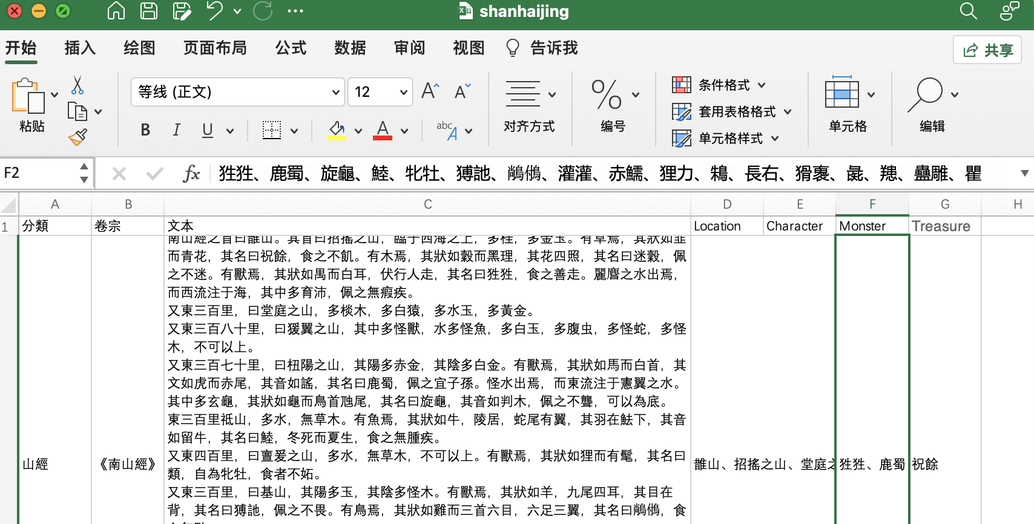
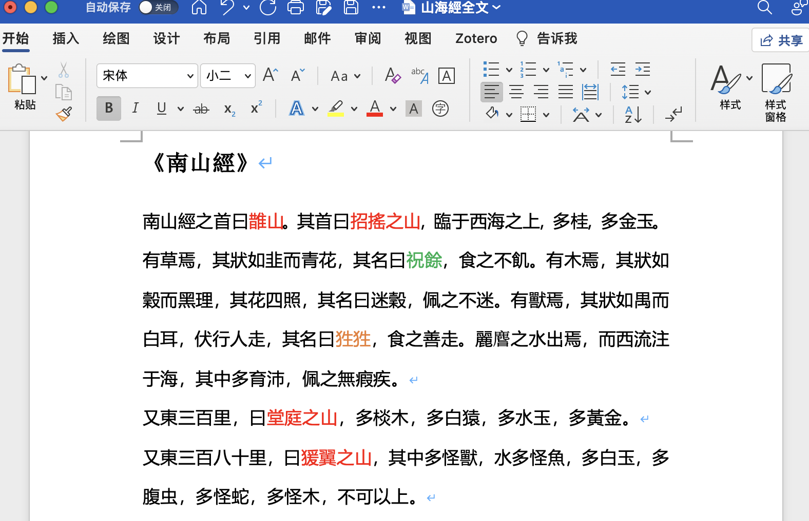
HUMA5630 Group3 Shen
02. Processing Humanities Data

Slide 15
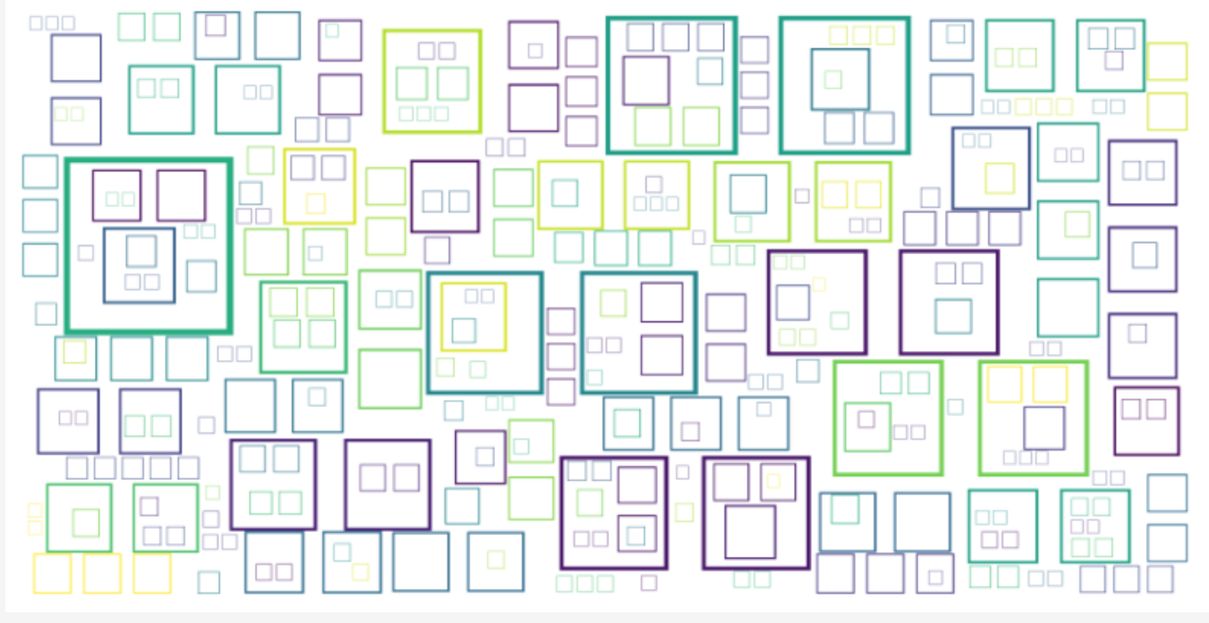
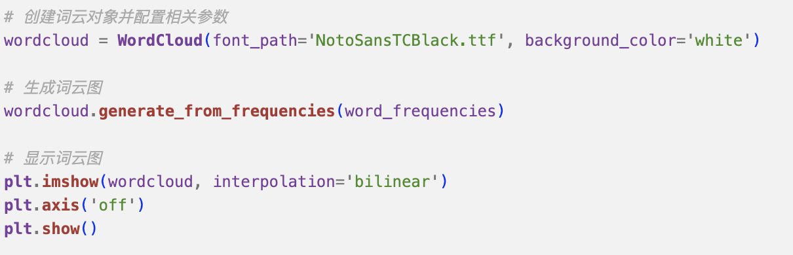
HUMA5630 Group3 Shen
03. Analyzing Humanities Data: Word Cloud
Word cloud, initial version➡️

Slide 16
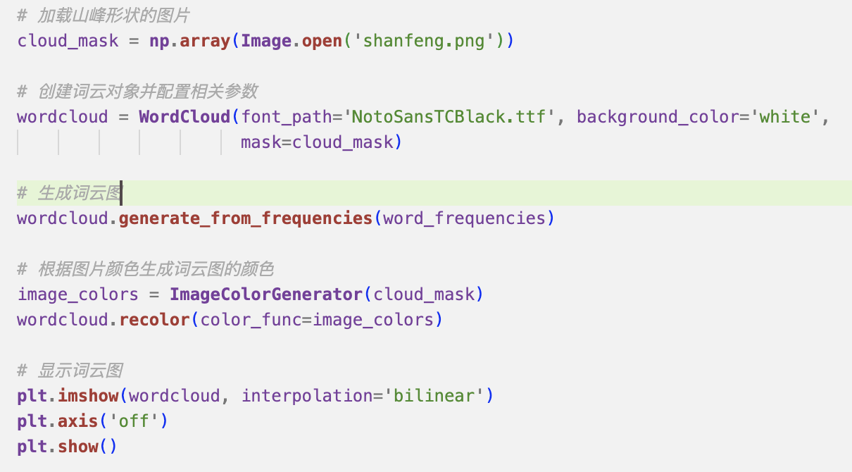
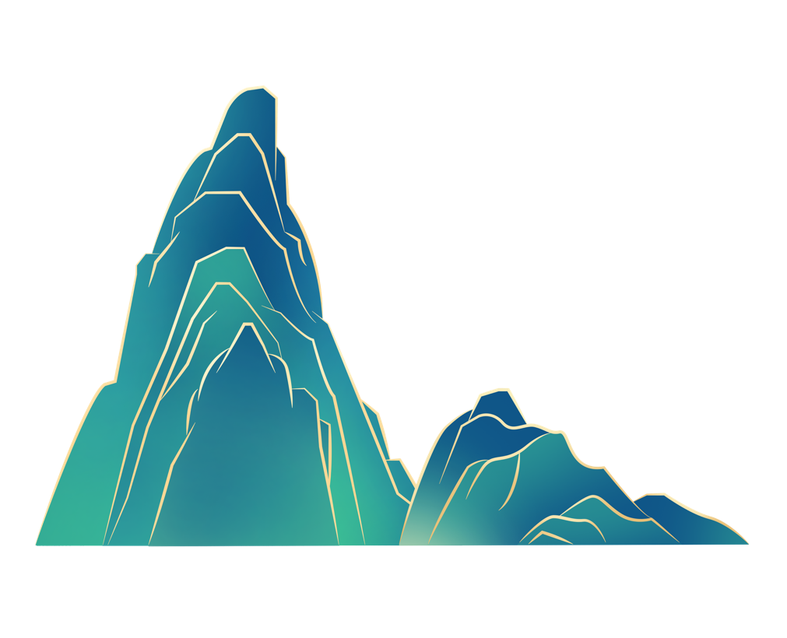
HUMA5630 Group3 Shen
03. Analyzing Humanities Data: Word Cloud
Shanfeng.png

Slide 17

HUMA5630 Group3 Shen
03. Analyzing Humanities Data: Word Cloud
Shanfeng.png
Word cloud, second version ➡️

Slide 18
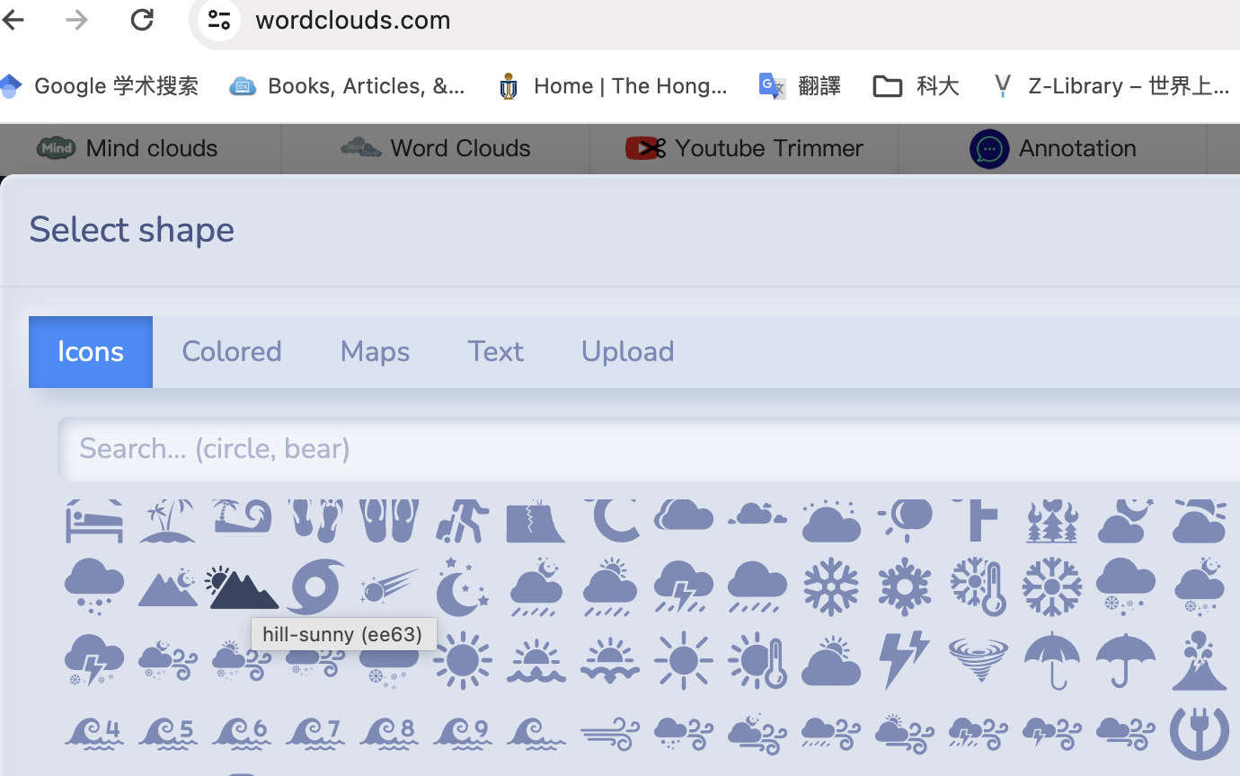
HUMA5630 Group3 Shen
03. Analyzing Humanities Data: Word Cloud
https://www.wordclouds.com/

Slide 19
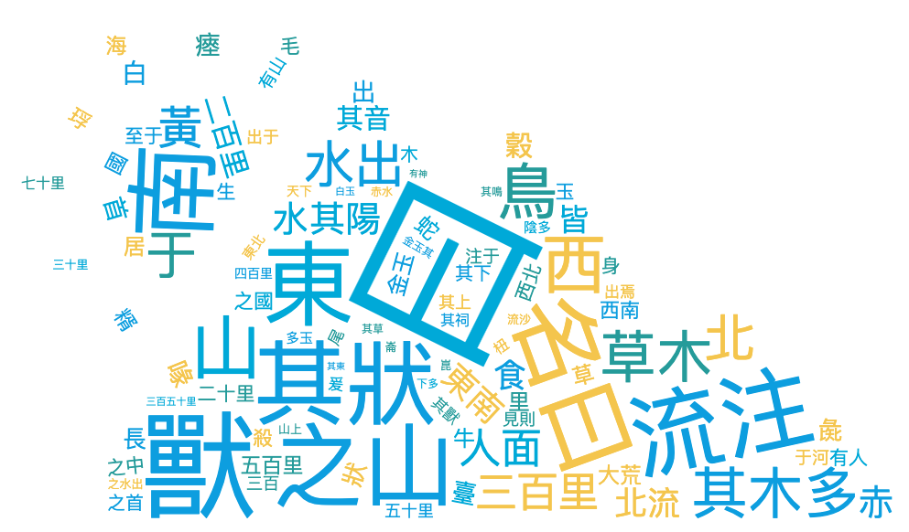
HUMA5630 Group3 Shen
04. Visualizing Humanities Data: Word Cloud
Word cloud, final version

Slide 20
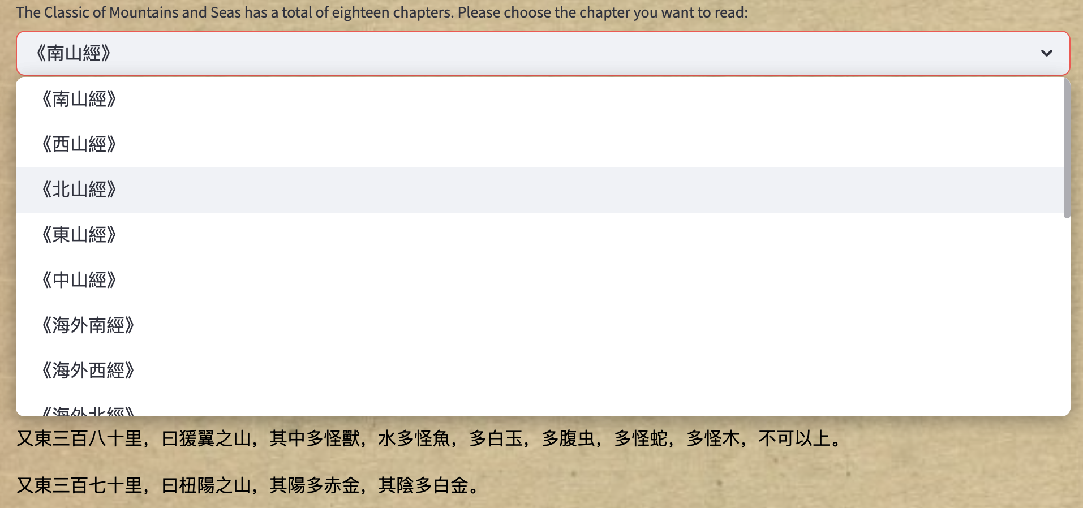
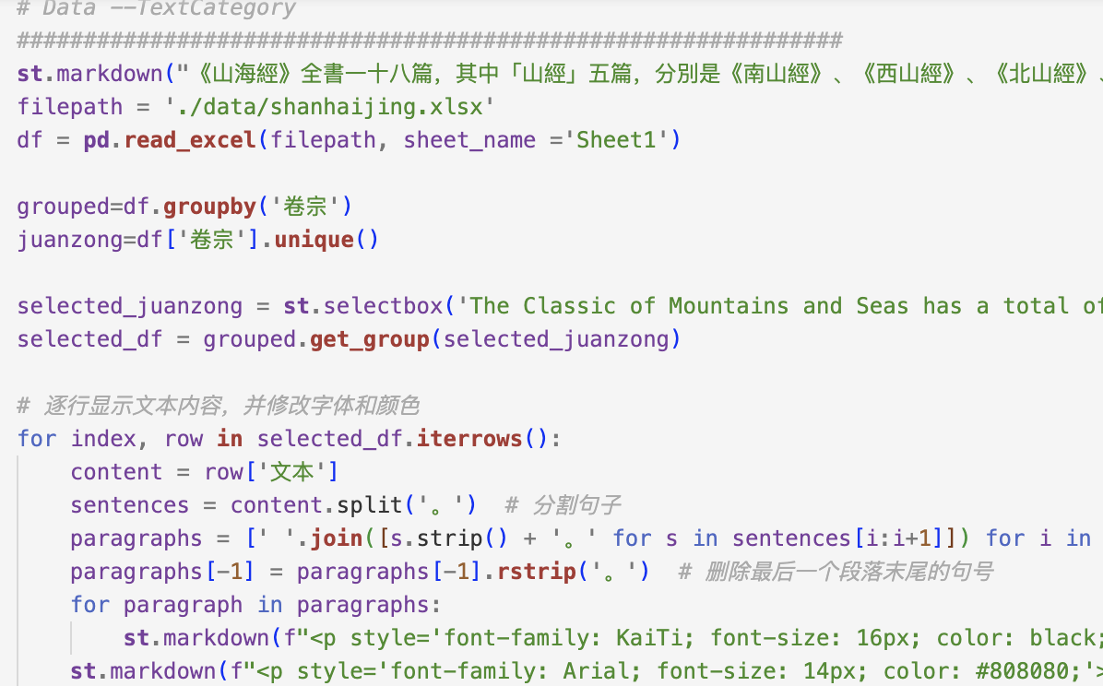
HUMA5630 Group3 Shen
05. Analyzing Humanities Data: Annotation on full text

Slide 21
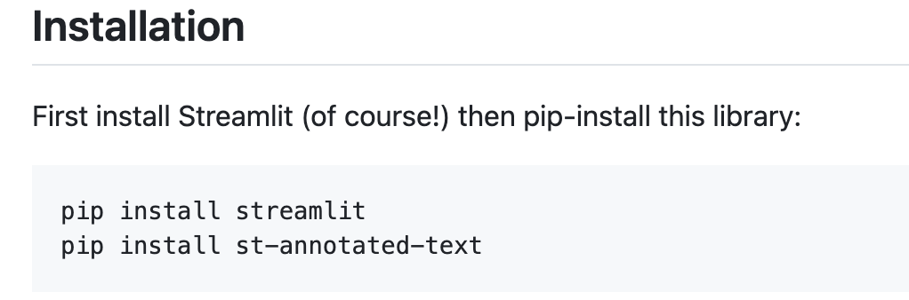
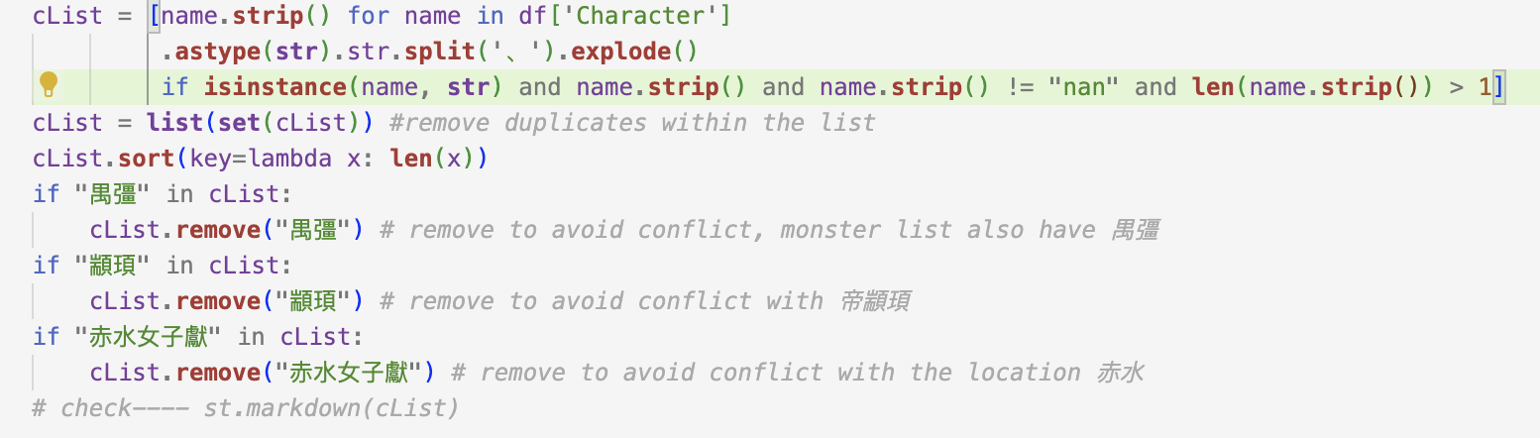
HUMA5630 Group3 Shen
05. Analyzing Humanities Data: Annotation on full text
*With the help of Holly

Slide 22
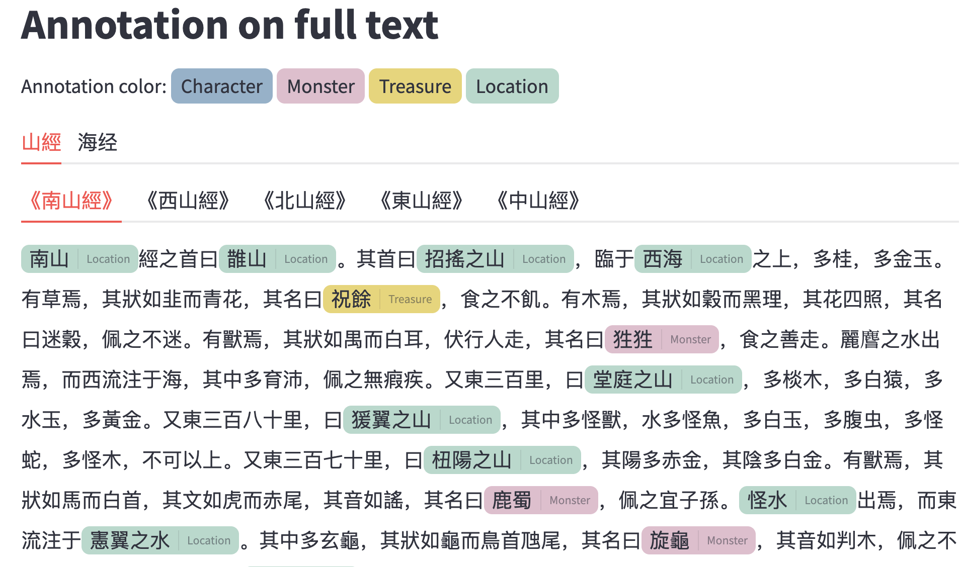
HUMA5630 Group3 Shen
06. Visualizing Humanities Data: Annotation on full text

Slide 23
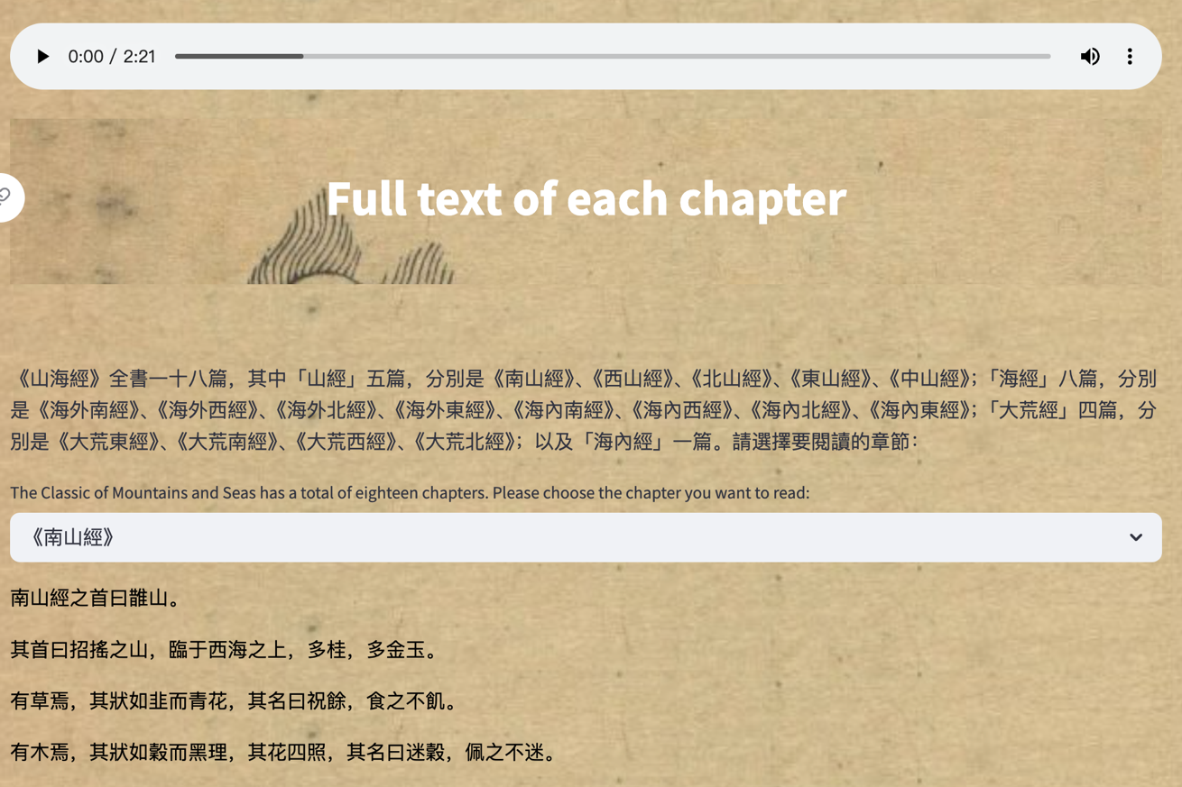
HUMA5630 Group3 Shen
06. Visualizing Humanities Data: Full text
To visit online demo

Slide 24
Part Two
Presenter: WU Yutong
Comparison Between Maps

Slide 25
My reserach question：
How does the map in the Classic of Mountains and Seas correspond to the modern map?
WU
2
Workflow
Finding a suitable map from the Internet
Uploading Map
& Rectifying
ComparingMaps Using Python
Visualizing & Publishing Data

Slide 26
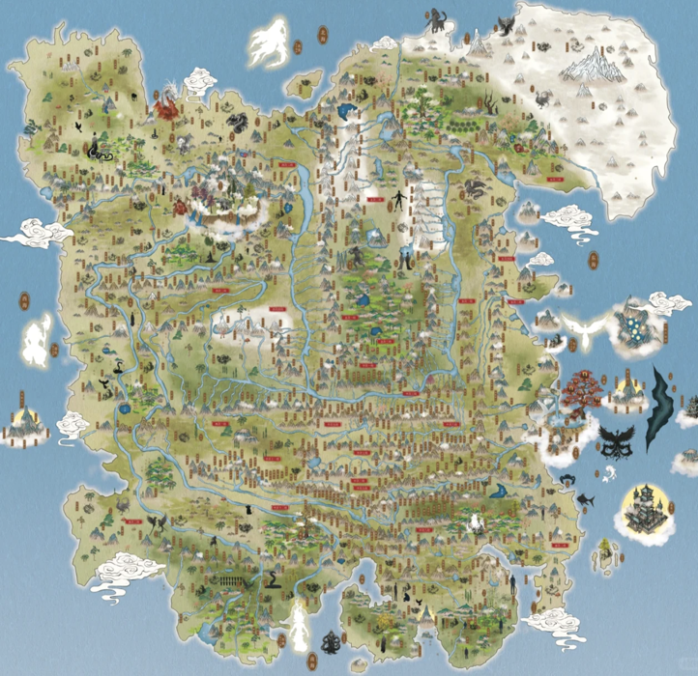
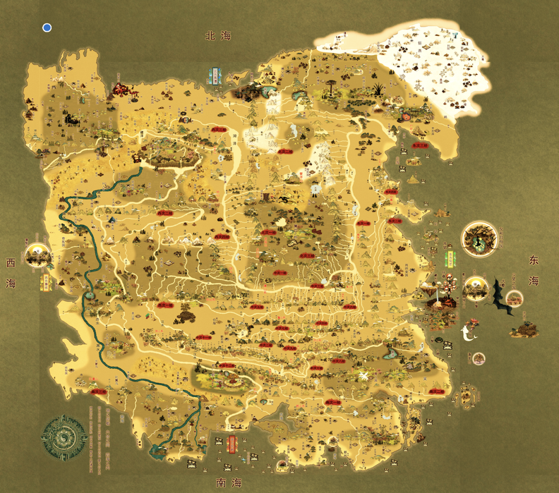
01.Finding a suitable map from the Internet
The first map I found
*With the help of teammate
The map I finally chose

Slide 27
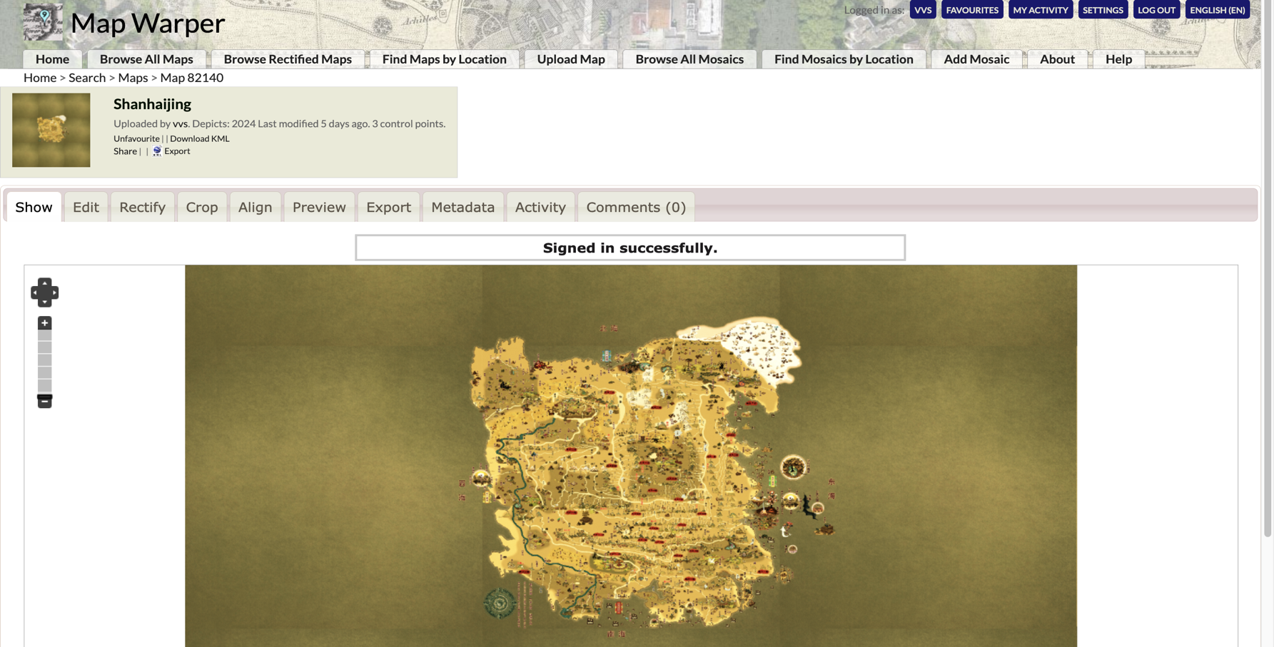
02.Uploading Map & Rectifying

Slide 28
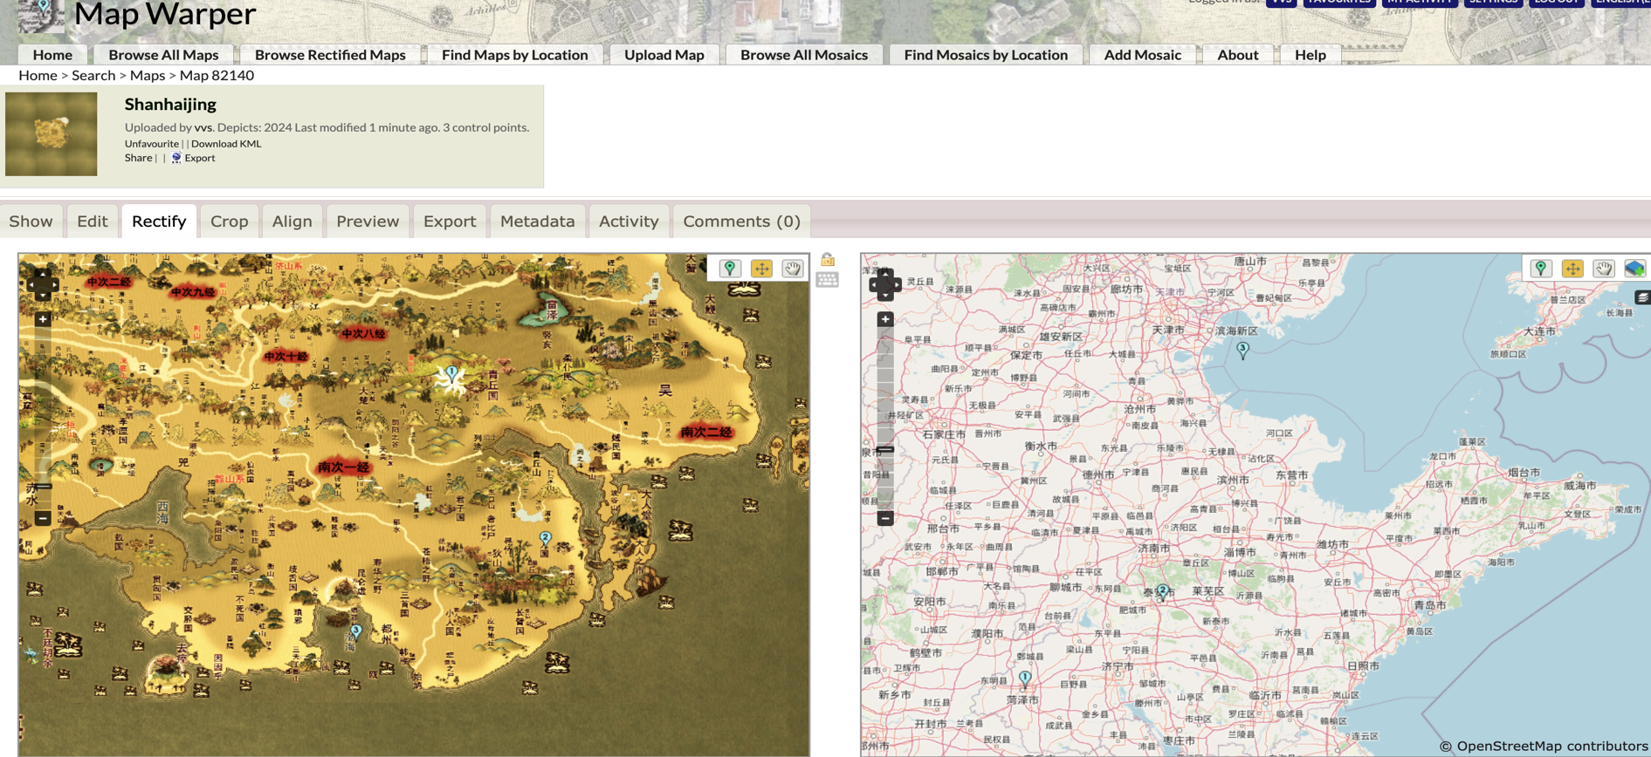
02.Uploading Map & Rectifying

Slide 29
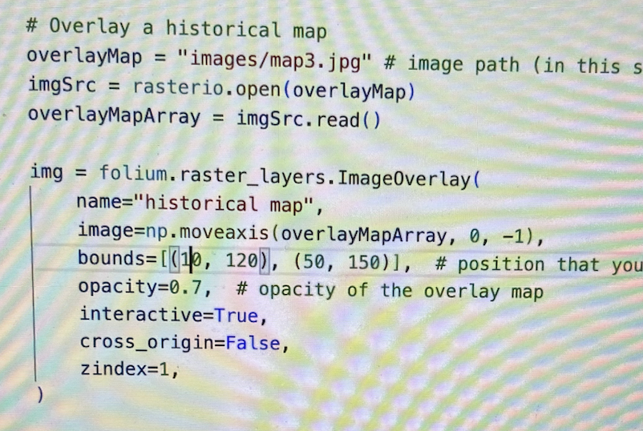
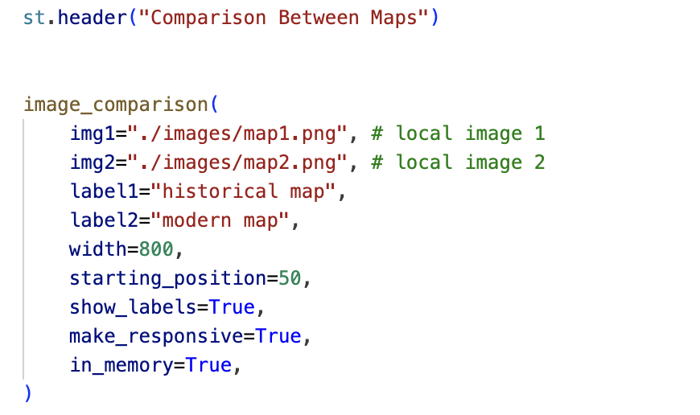
03.Comparing Maps Using Python
First attempt :
Overlaying historical map on modern map
Difficulties encountered
Final decision :
Comparing the two maps directly from left to right
*With the help of Holly

Slide 30
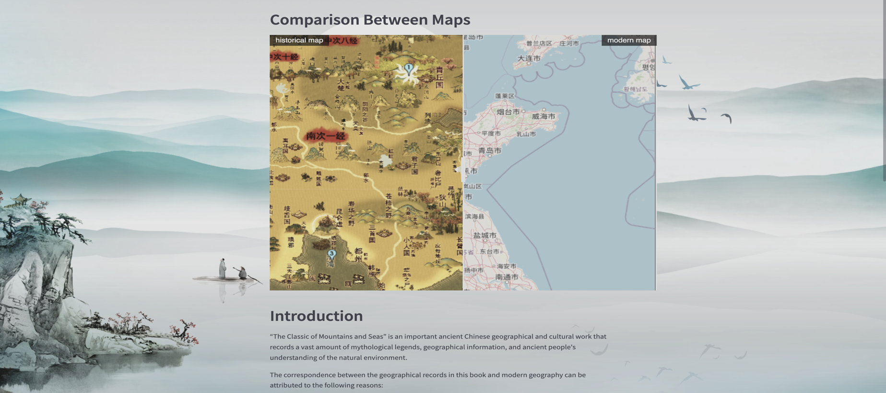
04.Visualizing & Publishing Data
Click here to view a demo

Slide 31
Categorization
Part Three
Presenter: HAN Xuan Lucy

Slide 32
Purpose：To analyze different types of mythical creatures in the Classic of Mountains and Seas《山海经》
Han Xuan
3. Categorization
Workflow
Acquiring Data from Library
Processing Data Using Excel
Analyzing Data Using Python
Visualizing & Publishing Data Using Python & Streamlit

Slide 33

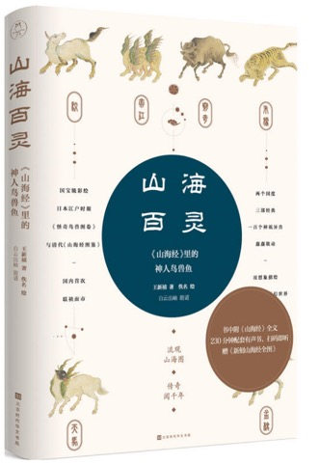
01.Acquiring Data from Library
Problem: The Classic of Mountains and Seas was written 4000 years ago and it records more than 450 mythical creatures. However, many pictures and text were lost in the later generations.
Han Xuan
3. Categorization
Workflow
王新禧. (2018). 山海百灵 : 《山海经》里的神人鸟兽鱼 = Shanhai bailing : Shanhaijing lide shen ren niao shou yu (第1版.). 北京时代华文书局.
Book: It contains different types of mythical creatures, including pictures, texts and explanations.

Slide 34
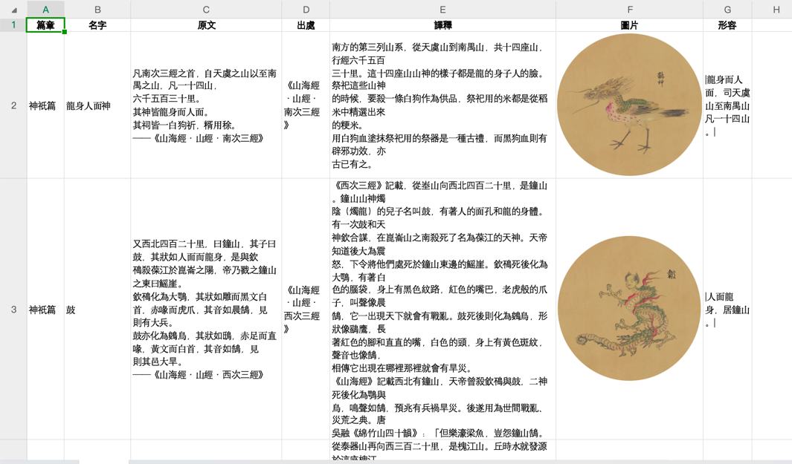

02.Processing Data Using Excel
Action: As this book is a PDF document, differentiate its content based on creatures’ origins, name of creatures, text, chapters, explanations, images, and descriptions, and fill them into an Excel file for convenient analysis in subsequent operations.
Han Xuan
3. Categorization
Workflow
Excel file: ‘./data/mythical_creatures.xlsx’

Slide 35
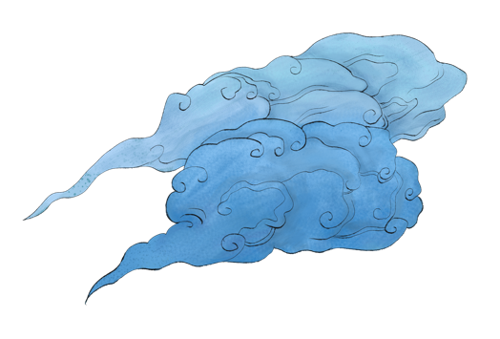
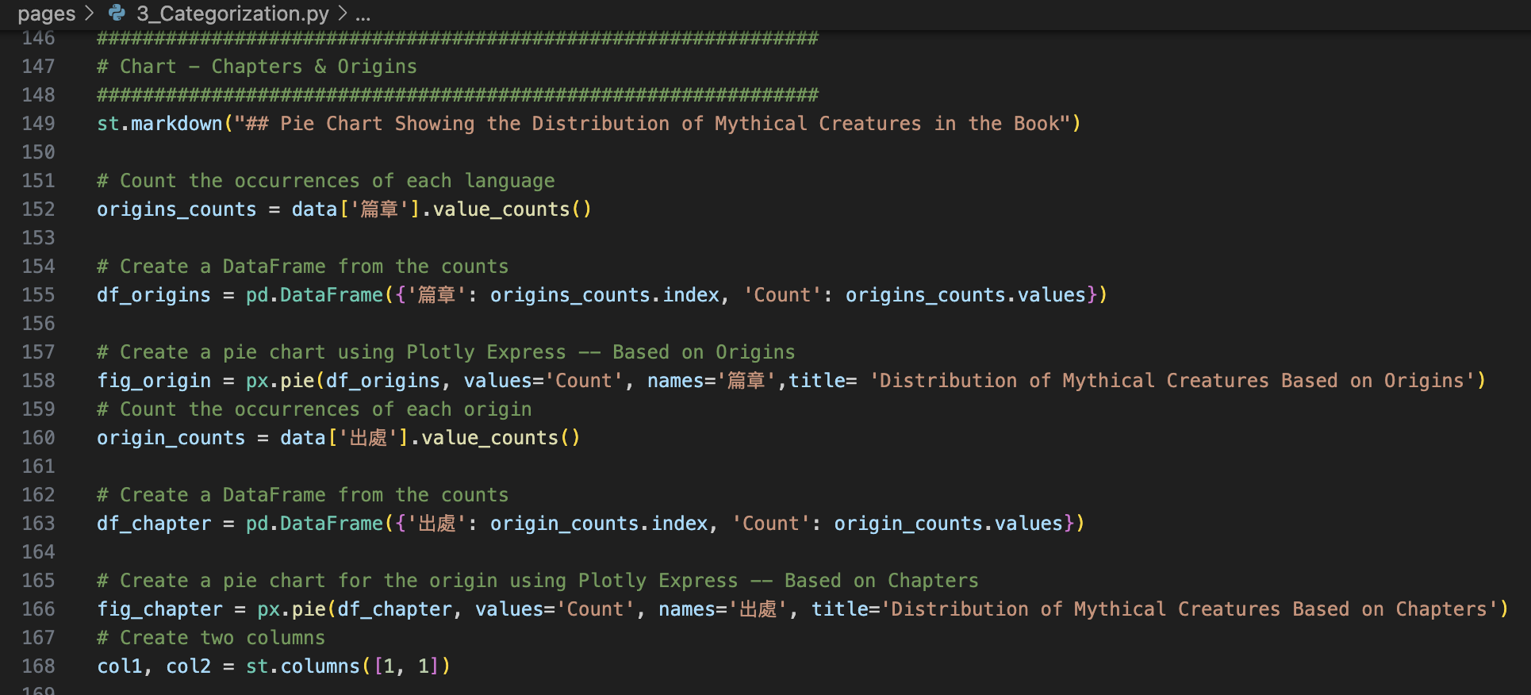
03.Analyzing Data Using Python
Action:
Count how many mythical creatures in the book of <ShanHai BaiLin>
Using chart to show the distribution of mythical creatures
Categorize the mythical creatures in the book
*With the help of ChatGPT
Han Xuan
3. Categorization
Workflow
Python file: ‘./pages/3_Categorization.py’

Slide 36
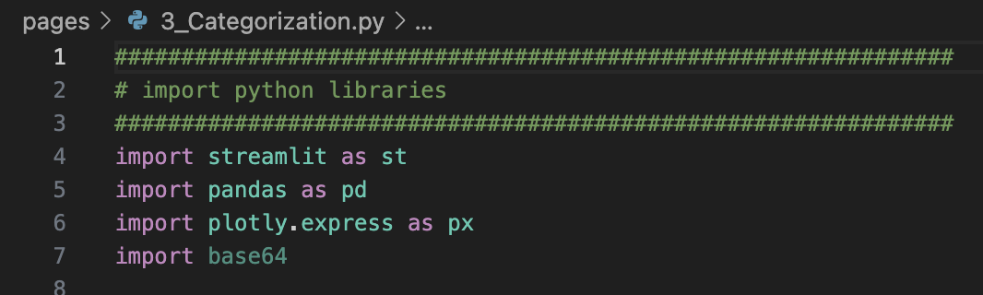
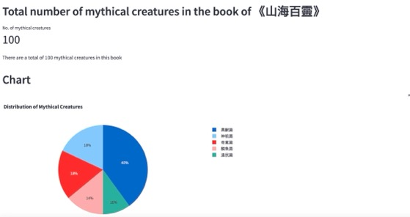
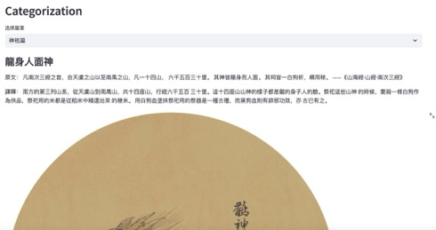
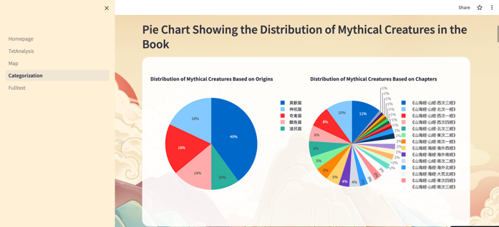
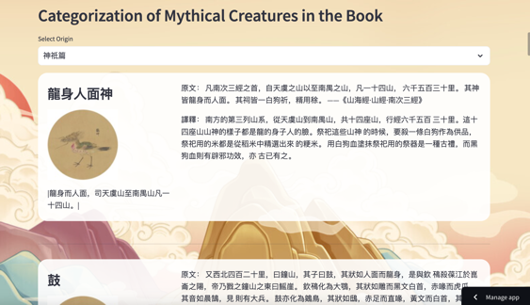

04.Visualizing & Publishing Data Using Python & Streamlit
Action:
Visualizing Data by importing Streamlit libraries into python
Improving UI design of the website
*with the help of ChatGPT & Holly
Han Xuan
3. Categorization
Workflow
Click here to see the Demo

Slide 37
5. Project Challenges

Slide 38

5. Challenges
·Language Barrier:
Challenge in translating it into English accurately
·Complex Geographic Descriptions:
Challenge in mapping out the locations mentioned
in the text and gaining a comprehensive
understanding of the ancient mythological world.
·Technical Difficulties:
The use of various techniques, such as word cloud,
mapping, and data analysis, may pose technical
difficulties for the project. This include issues
with data accuracy, and visualization design.

Slide 39
6. Future Improvement

Slide 40
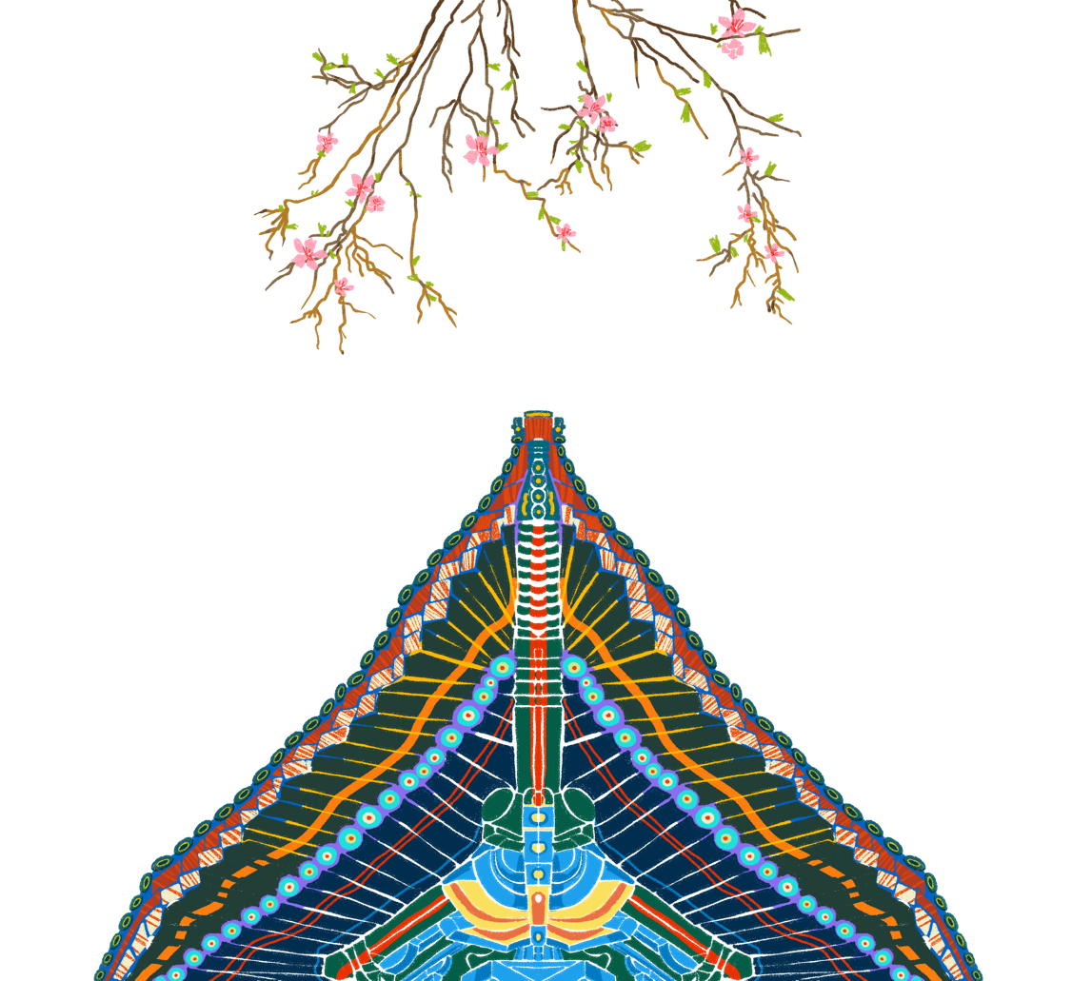
Develop a Digital Game about the Classic of Mountains and Seas
Interaction and User Engagement
VR Experience
Future
Improvement
Create an interactive game where users can participate, such as solving puzzles, answering quizzes, or engaging in role-playing.
Create a VR application where users can explore the world of Shanhai Jing, observe creatures, and visit different landscapes.
Group 3
Multi-language Support
Content Diversification
Consider translating the website content into multiple languages to reach a wider audience and promote Chinese culture to the world.
Consider adding more diverse content related to the Shanhai Jing. This could include story interpretations, character analyses, historical context, and more, to provide a comprehensive and immersive experience.

Slide 41
Thank You!
HUMA5630
Group 3

